Slide 1

Selections
TUIT
C++ Programming, Fall 2016
Lab #3
(I - part)

Slide 2
Read the lecture notes doing following tasks:
TUIT
Practice (I - part)
*Algebra: solve quadratic equations;
Check numbers;
*Algebra: solve 2 x 2 linear equations;
Check the speed;
*Find future dates;
**Compute the area of an equilateral triangle;
*Sort three integers;
*Comparing Integers;
*Sum the digits in an integer;
**Geometry: point in a circle?;
**Geometry: point in a rectangle?;
**Geometry: intersecting point;
**Geometry: points in triangle?;
**Geometry: Two Rectangles;
** Geometry: Two Circles;

Slide 3


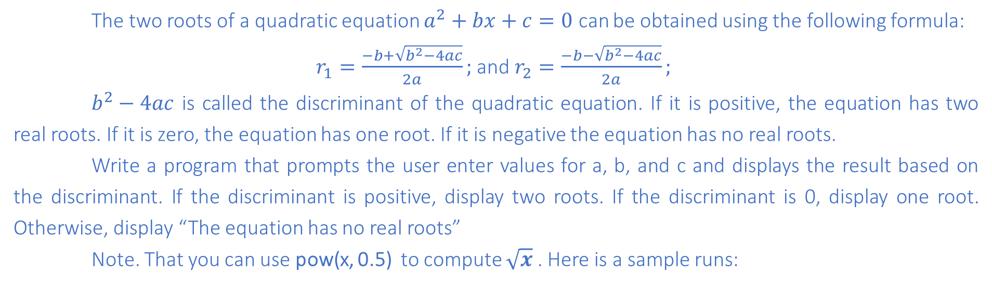
TUIT
1. *Algebra: solve quadratic equations
The two roots of a quadratic equation $a^{2}+bx+c=0$ can be obtained using the following formula:
$r_{1}=\frac{−b+\sqrt{b^{2}−4ac}}{2a};$ and $r_{2}=\frac{−b−\sqrt{b^{2}−4ac}}{2a};$
$b^{2}−4ac$ is called the discriminant of the quadratic equation. If it is positive, the equation has two real roots. If it is zero, the equation has one root. If it is negative the equation has no real roots.
Write a program that prompts the user enter values for a, b, and c and displays the result based on the discriminant. If the discriminant is positive, display two roots. If the discriminant is 0, display one root. Otherwise, display “The equation has no real roots”
Note. That you can use pow(x, 0.5) to compute $\sqrt{x}$ . Here is a sample runs:
Enter a, b, and c: 1.0 3 1 The roots are -0.381966 and -2.61803
Enter a, b, and c: 1 2.0 1 The root is -1
Enter a, b, and c: 1 2 3 The equation has no real roots

Slide 4
TUIT
2. Check Numbers
Write a program that prompts the user to enter two integers and checks whether the first number is divisible by the second.
Here is a sample run:
Enter two integers: 2 3 2 is not divisible by 3
Enter two integers: 22 2 22 is divisible by 2

Slide 5
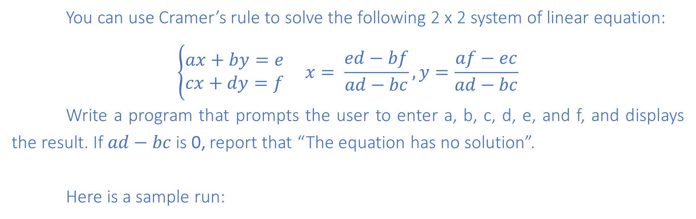
TUIT
3. *Algebra: solve 2 x 2 linear equations
You can use Cramer’s rule to solve the following 2 x 2 system of linear equation:
$$\left\{\begin{aligned}ax+by=e \\ cx+dy=f\end{aligned} x= \frac{ed−bf}{ad−bc}, y=\frac{af−ec}{ad−bc}\right.$$
Write a program that prompts the user to enter a, b, c, d, e, and f, and displays the result. If $ad−bc$is 0, report that “The equation has no solution”.
Here is a sample run:
Enter a, b, c, d, e, f: 9.0 4.0 3.0 -5.0 -6.0 -21.0 X is -2.0 and y is 3.0
Enter a, b, c, d, e, f: 1.0 2.0 2.0 4.0 4.0 5.0 The equation has no solution

Slide 6
TUIT
4. Check the speed
Write a program that prompts the user to enter the speed of a vehicle. If speed is less than 20, display too slow; if speed is greater than 80, display too fast; otherwise, display just right.
Here is a sample run:
Enter the speed of a vehicle: 55 just right

Slide 7
TUIT
5. *Find future dates
Write a program that prompts the user to enter an integer for today’s day of the week (Sunday is 0, Monday is 1, … , and Saturday is 6). Also, prompt the user to enter the number of days after today for a future day and display the future day of the week.
Here is a sample run:
Enter today’s day: 0 Enter the number of days elapsed since today: 31 Today is Sunday and the future day is Wednesday

Slide 8
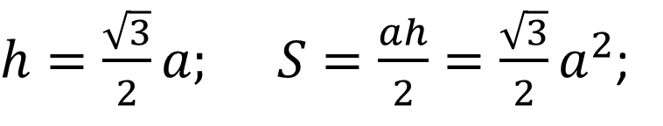
TUIT
6. **Compute the area of an equilateral triangle
Write a program that reads three edges of a triangle and computes the area if the input is valid. Otherwise, it displays that the input is invalid. The input is valid if all the edges of the triangle are equal.
a
$h=\frac{\sqrt{3}}{2}a; S=\frac{ah}{2}=\frac{\sqrt{3}}{2}a^{2}$;
a
h
a
Here is a sample run:
Enter three edges of a triangle: 5 4 3 The input is invalid

Slide 9
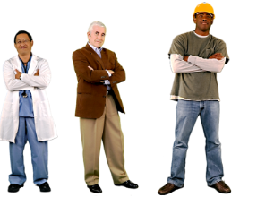
TUIT
7. *Sort three integers
Write a program that prompts the user to enter three integers and display the integers in non – decreasing order.
Here is a sample run:
Enter three integers: 5 1 3 Result: 1 3 5

Slide 10
TUIT
8. *Comparing Integers
Write a program that prompts the user to enter the edges of a triangle and compares them. If all edges are equal, display Equilateral Triangle; if only two edges are equal, display Isosceles Triangle and if non of the edges are equal, display Scalene Triangle.
Here is a sample run:
Enter the edges of a triangle: 5 6 7 Scalene Triangle

Slide 11
TUIT
9. *Sum the digits in an integer
Write a program that prompts the user to enter an integer between 0 and 1000, and displays the sum of all digits in the integer. Write a program that prompts the user to enter a three-digit integer. The program displays the sum of all digits in the integer if the input is valid; otherwise, it displays a message indicating that the integer is not a three-digit number and hence, is invalid.
Here is a sample run:
Enter an integer: 123 Sum of all digits in the integer: 6

Slide 12
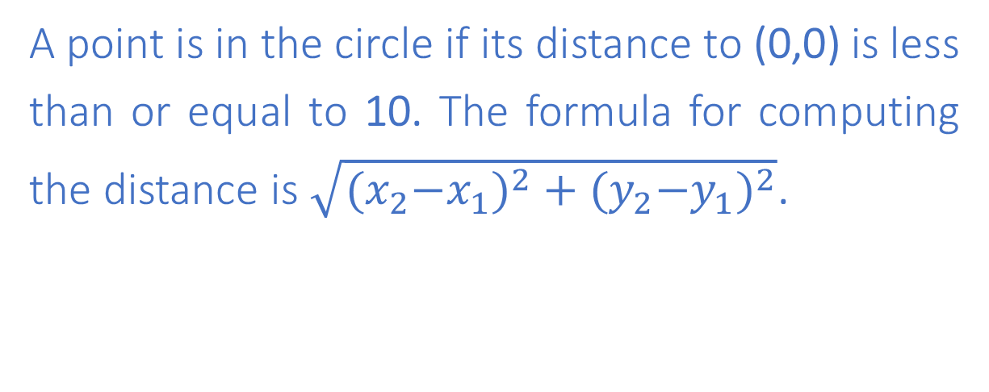
TUIT
10. **Geometry: Point in a circle?
Write a program that prompts the user to enter a point (x, y) and checks whether the point is within the circle centered at (0, 0) with radius 10.
y - axis
A point is in the circle if its distance to (0,0) is less than or equal to 10. The formula for computing the distance is $\sqrt{{{(x}_{2}−x_{1})}^{2}+{{(y}_{2}−y_{1})}^{2}}$.
(9,9)
(4,5)
(0,0)
x - axis
Here is a sample run:
Enter a point with two coordinates: 4 5 Point (4, 5) is in the circle

Slide 13
TUIT
11. **Geometry: Point in a rectangle
Write a program that prompts the user to enter a point (x, y) and checks whether the point is within the rectangle centered at (0, 0) with width 10 and height 5.
y - axis
(6,4)
(2,2)
(0,0)
x - axis
Here is a sample run:
Enter a point with two coordinates: 6 4 Point (6, 4) is not in the rectangle

Slide 14


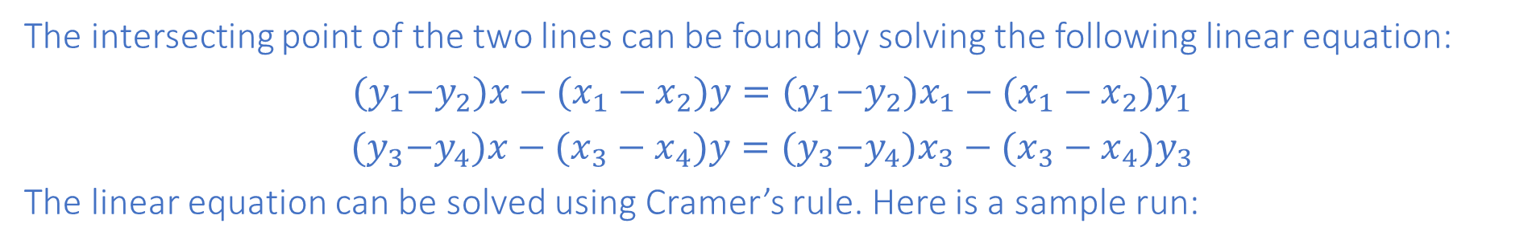










TUIT
12. *Intersecting point
Two points on line 1 are given as (x1, y1) and (x2, y2) and on line 2 as (x3, y3) and (x4, y4).
$$(x_{2},y_{2})$$
$$(x_{2},y_{2})$$
$$(x_{2},y_{2})$$
$$(x_{3},y_{3})$$
$$(x_{4},y_{4})$$
$$(x_{4},y_{4})$$
$$(x_{3},y_{3})$$
$$(x_{3},y_{3})$$
$$(x_{1},y_{1})$$
$$(x_{1},y_{1})$$
$$(x_{1},y_{1})$$
$$(x_{4},y_{4})$$
The intersecting point of the two lines can be found by solving the following linear equation:
$${(y}_{1}−y_{2})x−(x_{1}−x_{2})y={(y}_{1}−y_{2})x_{1}−(x_{1}−x_{2})y_{1}$$
$${(y}_{3}−y_{4})x−(x_{3}−x_{4})y={(y}_{3}−y_{4})x_{3}−(x_{3}−x_{4})y_{3}$$
The linear equation can be solved using Cramer’s rule. Here is a sample run:
Enter x1, y1, x2, y2, x3, y3, x4, y4: 2 2 5 -1.0 4.0 2.0 -1.0 -2.0 The intersecting point is at (2.88889, 1.1111)

Slide 15
TUIT
13. *Geometry: points in triangle?
Suppose a right triangle is placed in a plane as shown below. The right – angle point is placed at (0, 0), and the other two points are placed at (200, 0), and (0, 100). Write a program that prompts the user to enter a point with x – and y – coordinates and determines whether the point is inside the triangle.
(0,100)
p2
p1
(0,0)
(200,0)
Here is a sample run:
Enter a point’s x – and y – coordinates: 100.5 25.5 The point is in the triangle

Slide 16
TUIT
14. **Geometry: two rectangles
Write a program that prompts the user to enter the center x – , y – coordinates, width, and height of two rectangles and determines whether the second rectangle is inside the first or overlaps with the first.
w1
w1
w2
w2
h1
(x1,y1)
h1
(x1,y1)
h2
h2
(x2,y2)
(x2,y2)
Here is a sample run:
Enter r1’s center x-, y-coordinates, width, and height: 2.5 4 2.5 43 Enter r2’s center x-, y-coordinates, width, and height: 1.5 5 0.5 3 r2 is inside r1
Enter r1’s center x-, y-coordinates, width, and height: 1 2 3 3 Enter r2’s center x-, y-coordinates, width, and height: 40 45 3 2 R2 does not overlap r1

Slide 17
TUIT
15. ** Two circles
Write a program that prompts the user to enter the center coordinates and radius of two circles and determines whether the second circle is inside the first or overlaps with the first.
r1
r1
r1
(x1,y1)
(x1,y1)
(x1,y1)
r2
r2
r2
(x2,y2)
(x2,y2)
(x2,y2)
Here is a sample run:
Enter circle1’s center x-, y-coordinates, and radius: 3.4 5.7 5.5 Enter circle2’s center x-, y-coordinates, and radius: 6.7 3.5 3 Circle2 overlaps circle1

